Slide 1
San Mateo County Association of Grand Jurors San Mateo County Civil Grand Jury

Slide 3
What is it? What does it do? Why is it important? How you can take part

Slide 4
What Is It?
Nineteen qualified citizen volunteers; diverse backgrounds, representative of the entire county
Every county, only in California
Your watchdog over local government

Slide 5
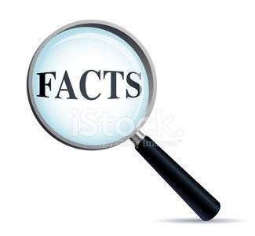
What Does It Do?
Investigates effectiveness, efficiency, and problems in local government
Diverse viewpoints discussed, a supermajority is needed
Not a criminal grand jury

Slide 6
What Does It Do?
Investigates, researches,
interviews, and deliberates all in
confidence – for life
Well researched, substantial
reports on findings with
recommendations for improvement

Slide 7
What Does It Do?
Hot topics in the news
Citizen complaints
Follow up previous investigations
Mandatory jail inspections

Slide 8
What Does It Do?
Researching and reading
Investigating and interviewing
Writing and deliberating
Final reports

Slide 9
Why Is It Important?
Saves taxpayer money
Improves government services
Roots out incompetence and identifies problems
Shines a light on key issues and concerns

Slide 10
Why Is It Important?
Recent Reports
Soaring pension costs for cities
Harbor District dysfunction
Menlo Park Fire District management
County budget decisions

Slide 12
How Can You Take Part?
A U.S. citizen, 18+, lived in the county a year and enjoy teamwork and learning
Have working knowledge of English
Commit to one year of service, with flexibility
of hours needed (July 1- June 30)
Computer skills: email, web search, Word, Excel, PowerPoint, etc.

Slide 13
How Can You Take Part?
Learn More, Read Final Reports, Apply, Suggest An Inquiry
sanmateocourt.org/court_divisions/grand_jury

Slide 14
Questions?
John McDowell
johnmcd@hotmail.com
202-390-7555
San Mateo County Association of Grand Jurors
http://www.co.sanmateo.ca.us/smcagj/about.html

