Slide 1
Dee Schweitzer CGJA Grand Jury Trainer Presenter
This Ain’t No Ham Sandwich
July 24, 2020
Rotary Club of Sebastopol
Notes:
Good afternoon!
I’m happy to be here with to you today because as I understand it, you’re people who care about what’s happening in Sonoma County and with a perspective of doing the right thing.
In 15 - 20 minutes I hope to give you a brief overview of the grand jury, give you information on jurors - who they are and how chosen , some key operating principles of grand juries, and finally some bits about Sonoma county reports.

Slide 2
Agents of Change
Video Introduction to California Grand Jury Service
California Grand Jurors Association
Notes:
First we’ll see a short 4 minutes video that helps show how grand jury service is participatory governance. It’s a bit dated but still good introduction “Agents of Change” compliments of the California Civil Grand Jurors Association.

Slide 3
Agents of Change Video
Notes:
Play Video

Slide 4
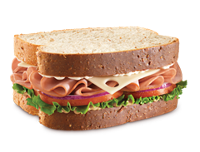
This Ain’t No Ham Sandwich!
“The District Attorney could get a grand jury to indict a ham sandwich.”
Rochester NY Columnist Jack Anderson 1982
Justice Sol Wachtler NY Court of Appeals 1985
Made popular by Tom Wolfe in Bonfire of the Vanities 1987
Notes:
You may be familiar with this saying about grand juries. Read quote. Origins mostly attributed to Justice Wachler but became popular by Tom Wolfe in The Bonfires of the Vanities
So there is a truth to the fact that statistically grand juries do support all criminal indictments as presented to them by the prosecution.
However, be assured that your Sonoma county civil grand jury is not indicting the proverbial ham sandwich and I trust that will be evident as I tell how civil is so different from criminal.

Slide 5
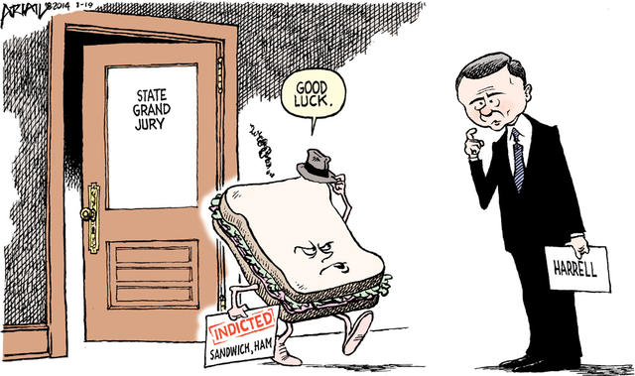
California Grand Jury System
California constitution mandate since 1879. Article 1.23
Penal Code 888 – 940 ~ what the grand jury MUST do and MUST NOT do
Civil Grand Jury serves as investigator, prosecutor, defense and jury
May also serve as criminal grand jury but not done in Sonoma County
Notes:
While grand jurors in a criminal case have all the evidence and argument presented to them. In a civil grand jury, jurors serve as their own investigators, prosecutors, defense and jury. No criminal grand juries are convened by the DA in Sonoma County.

Slide 6
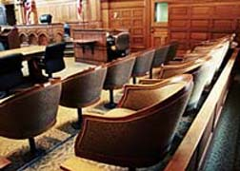
Grand Jurors
Who can be a grand juror?
How do I become a grand juror candidate?
Who decides who serves?
Notes:
Read the questions

Slide 7
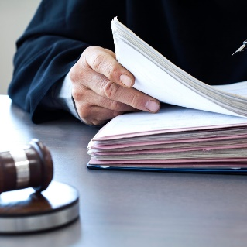
Sonoma County Application Process http://Sonoma.courts.ca.gov/info/administration/grand-jury
Application Form ~ Grand Jury Application Form
Orientation Session
Meeting with a Judge
Lottery ~ Am I a winner?
Notes:
Grand jurors must meet specific basic criteria such as residency, age, and no criminal record. See p 1 of application Anyone who meets the basic criteria can apply. There is a vetting process (which has been enhanced recently) through meeting with a judge and then applicants are chosen by lottery. Names on a piece of paper pulled out of a box.

Slide 8
In the Grand Jury Room
Ground Rules
Supermajority Rules
Foreperson and Juror Roles
Committees ~ administrative and investigative
Notes:
No matter who the jurors are and who serves as foreperson (the only role and person chosen by the judge) decisions are all made by the whole group. Supermajority is the law. So neither the foreperson nor any one individual gets to decide on what gets investigated. All investigations, public actions and reports must be approved by the supermajority minimally – goal is consensus.

Slide 9
Topic Selection
Citizen complaint
Current News
Juror Interest
Notes:
Consistent with the penal code, well established practice and with their own policies and procedures, topics for investigation can come from citizen complaints, current news/hot topics, or simply current juror interest. Requirement is investigate at least one county entity or department annually.

Slide 10
Key Concepts
Confidentiality ~ PC924.1
Independence
Ethics
Collegiality
Continuity
Budget I’ve Got a Secret
Notes:
Key to all of this is penal code 924.1 the rule of confidentiality. Jurors are sworn to secrecy and must take an oath when empaneled. Violation is a misdemeanor. Confidentiality helps preserve the grand jury’s autonomy and protects witnesses and whistleblowers.
Continuity is not explicitly addressed in the penal code but because responsible officials are required by law to respond within a specific time frame, you’ll see Sonoma County includes a report on follow up from the previous term’s recommendations.
Since CGJ is an unfunded mandate, we are blessed by the county’s generosity to have a budget. Sonoma County is adequate for the grand jury to do its job. Laptops and IT support, access to use county email.

Slide 11
Sonoma County Reports
Reports posted on the Sonoma County Court website:
www.Sonoma.courts.ca.gov/info/administration/grand-jury
Citizen complaint ~ 2020 Sonoma Zoning; 2019 Behavioral Health Budget
http://sonoma.courts.ca.gov/sites/all/assets/pdfs/general-info/grand-jury/complaint1.pdf
Current News ~ 2017 Fires; Emergency Preparedness
Juror Interest ~ 2020 Coroner Follow Up; 2019 County Assets
Notes:
Examples of reports initially based on citizen complaints:
2020 Process the issue not the zoning itself.
2019 Numerous complaints on county behavioral health budget.
To ask CGJ to investigate something, send Citizen compliant form
Confidential and helps think through what you’re expecting from GJ
News: fires, emergency prep for pandemic
Juror interest or self-initiated: 2020 coroner report; 2019 assets

Slide 12
GJ Overseers Presiding Judge DeMeo – 2 year rotation Court Executive Officer Arlene Junior County Administrative Officer Cheryl Bratton Legal Advisor – County Counsel Bruce Goldstein
Current Term
Status ~ 2019-2020 jurors continue to end of August
New Term 2020-20121 recruitment, orientation, empanelment, training
???
Notes:
While the grand jury has so much autonomy, and is watching the county, who’s watching the grand jury?
Grand jury reports to the court. It is the state superior court system.
Presiding Judge; CEO; CAO; Legal Advisor.
Current term….

Slide 13
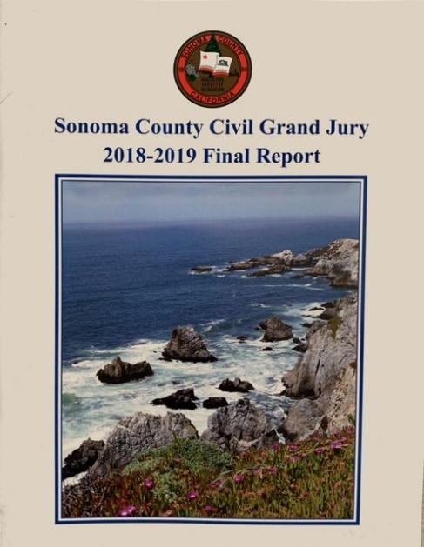
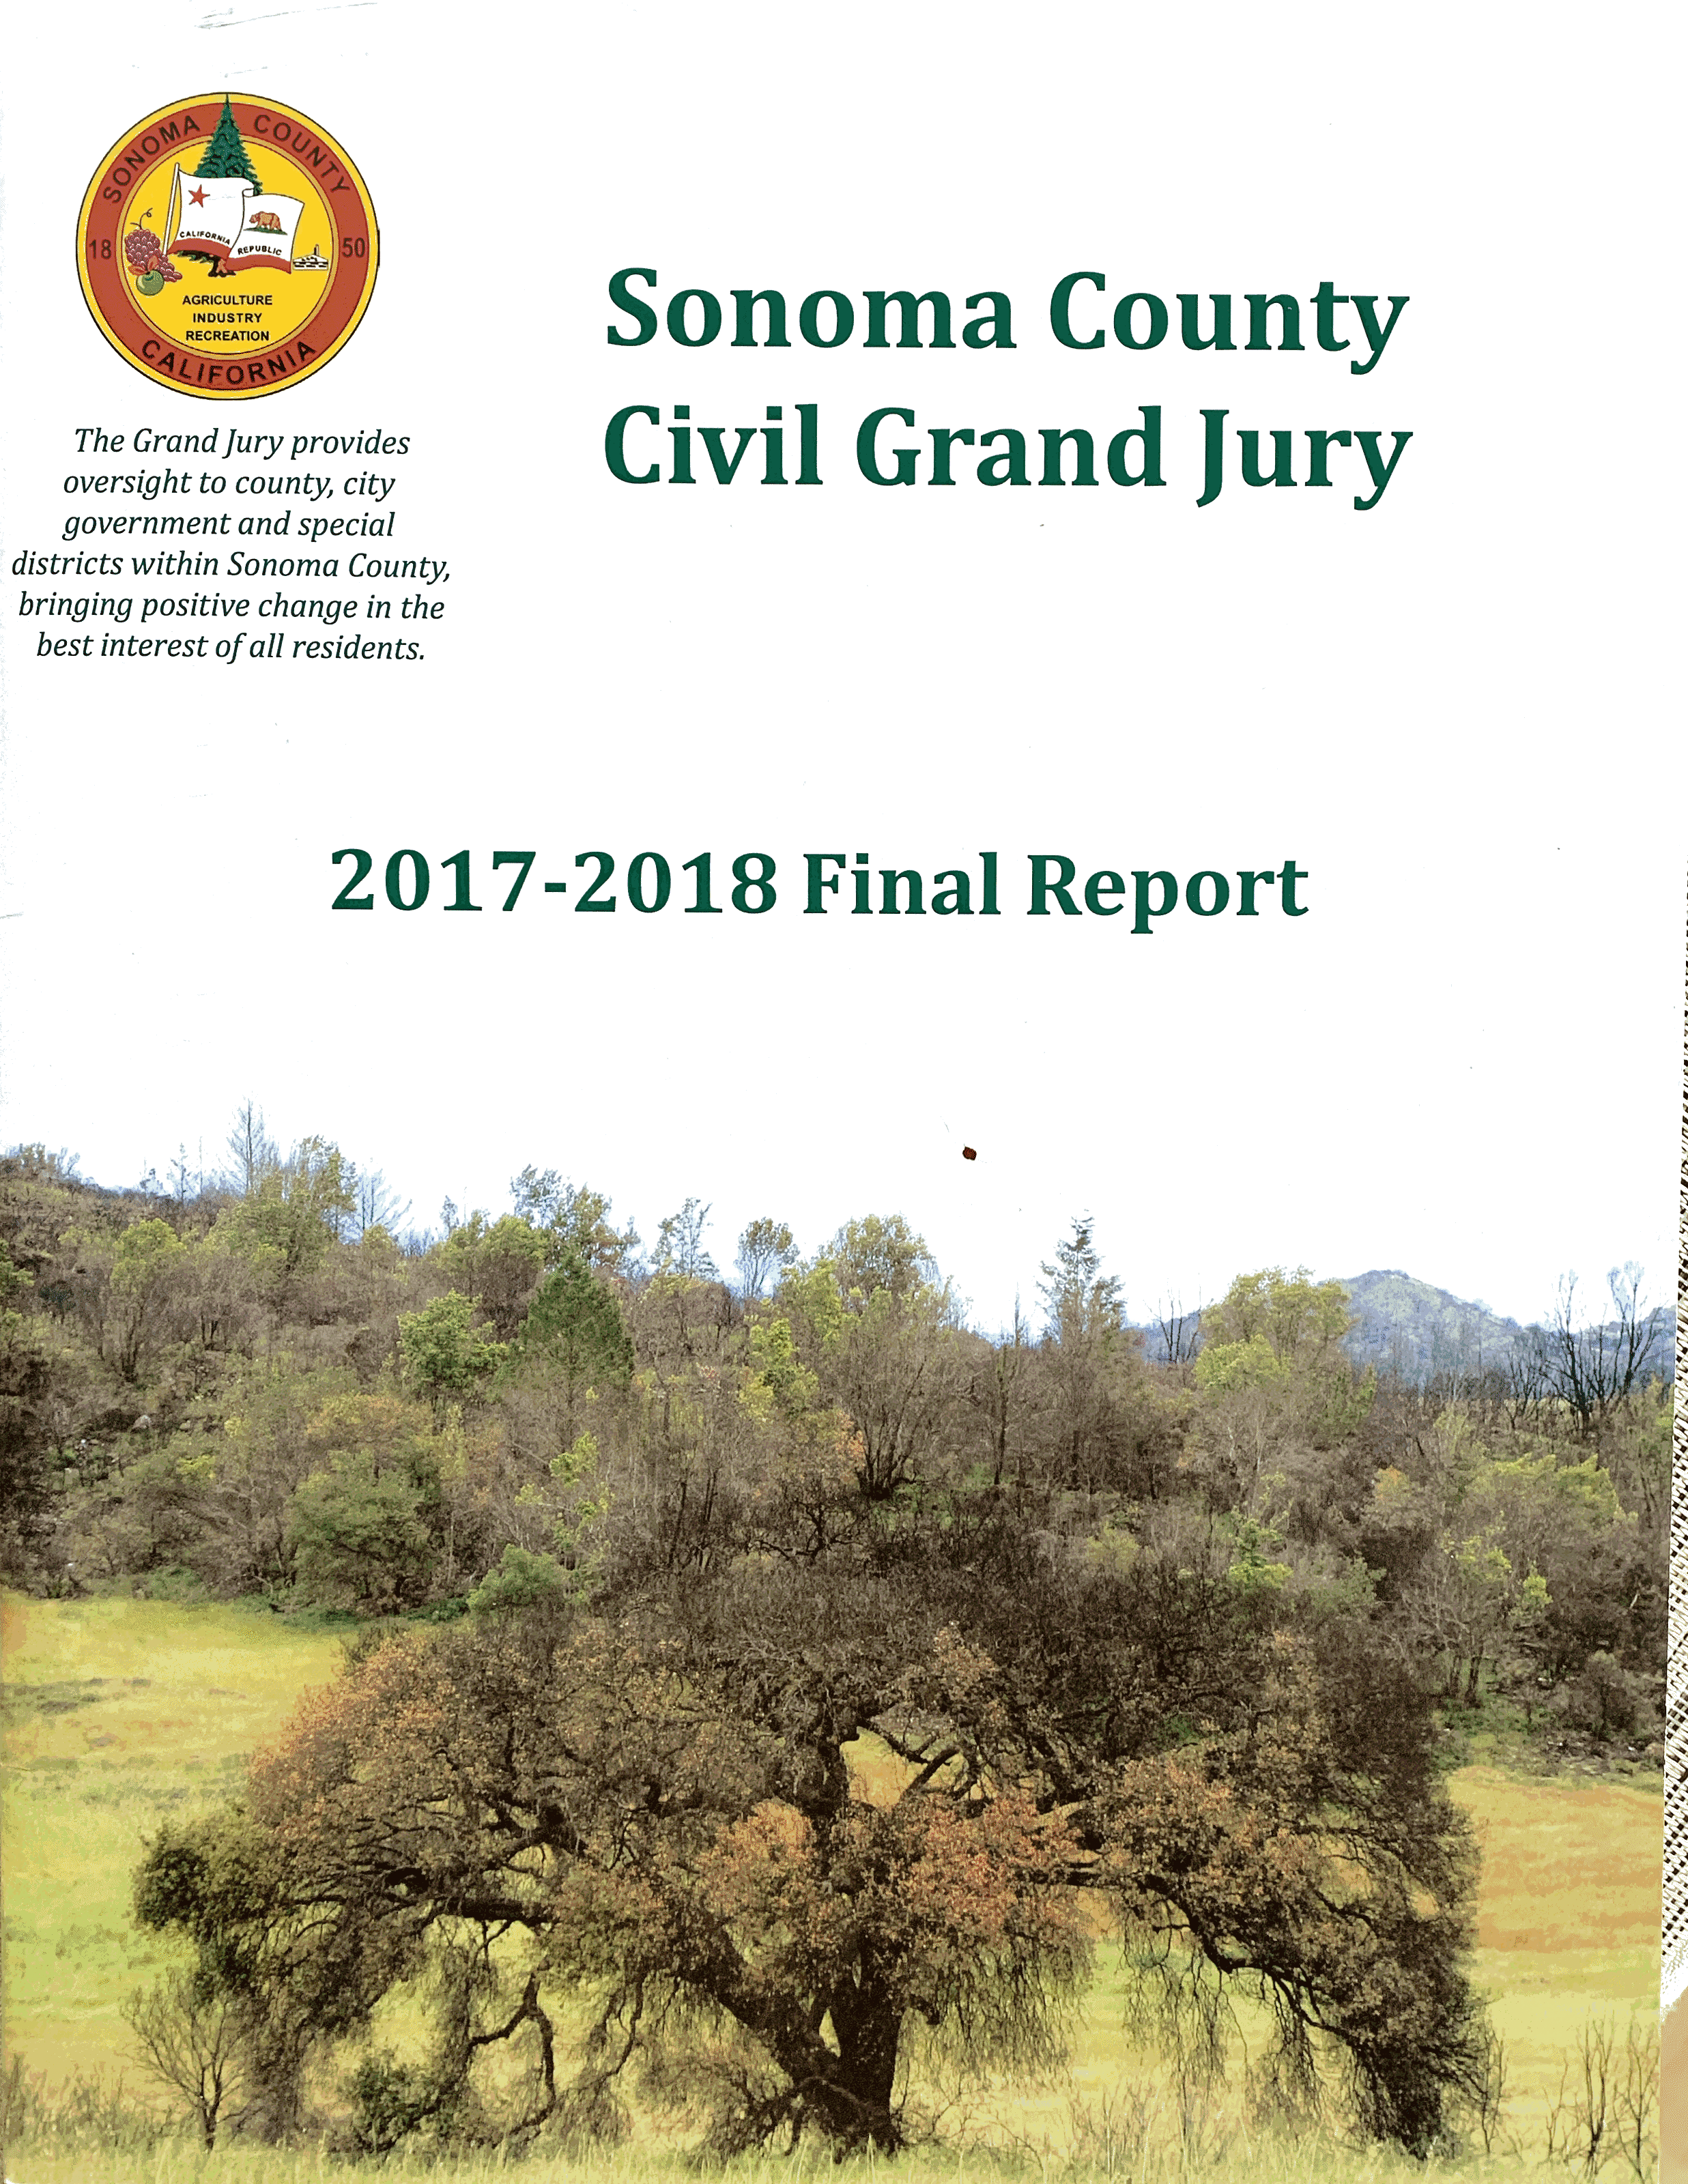
Resources Sonoma County Civil Grand Jury Court website: http://Sonoma.courts.ca.gov/info
http://Sonoma.courts.ca.gov/info/administration/grand-jury
For the Grand Jury Reports, go to Court Administration/Grand Jury. Final Reports and Responses are listed by year
For application to serve on the grand jury, print and send a completed Grand Jury Application Form
Notes:
Read your Sonoma County grand jury reports
Posted on the court website. I’ve given Pam a list of links
Go and search, poke around

Slide 14
Resources
California Courts Judicial Branch https://www.courts.ca.gov/civilgrandjury
The California Civil Grand Jurors Association (CGJA) www.cgja.org
Tab About CGJA/About Grand Juries:
Primer of CA Grand Jury System
History of Grand Juries
Agents of Change
Notes:
Judicial branch of the state court website also has CGJ information
CGJA wealth of information

Slide 15
Q & A
Dee Schweitzer
deesartx@gmail.com

